Slide 1

OBJECT DETECTION USING THERMAL IMAGES
BTP Code: B23RVP01
Team members
E.Jaswanth Krishna - S20200020257
A.Gopal Reddy - S20200020248
Mentor -Dr Raja Vara Prasad Y

Slide 2
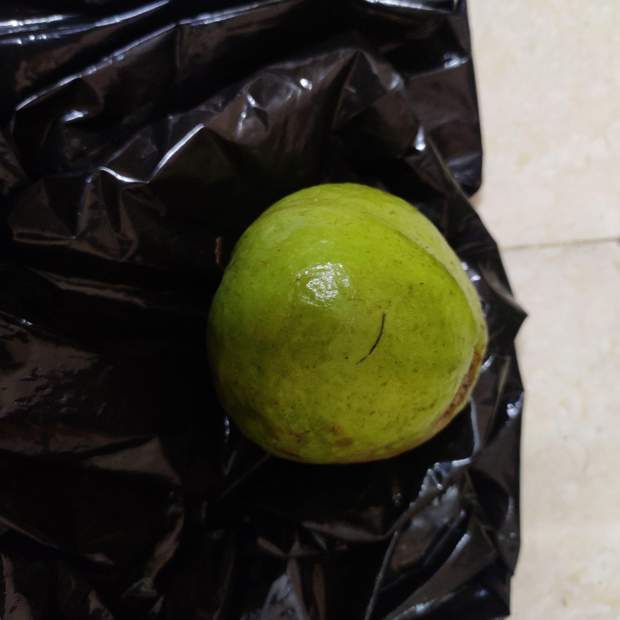
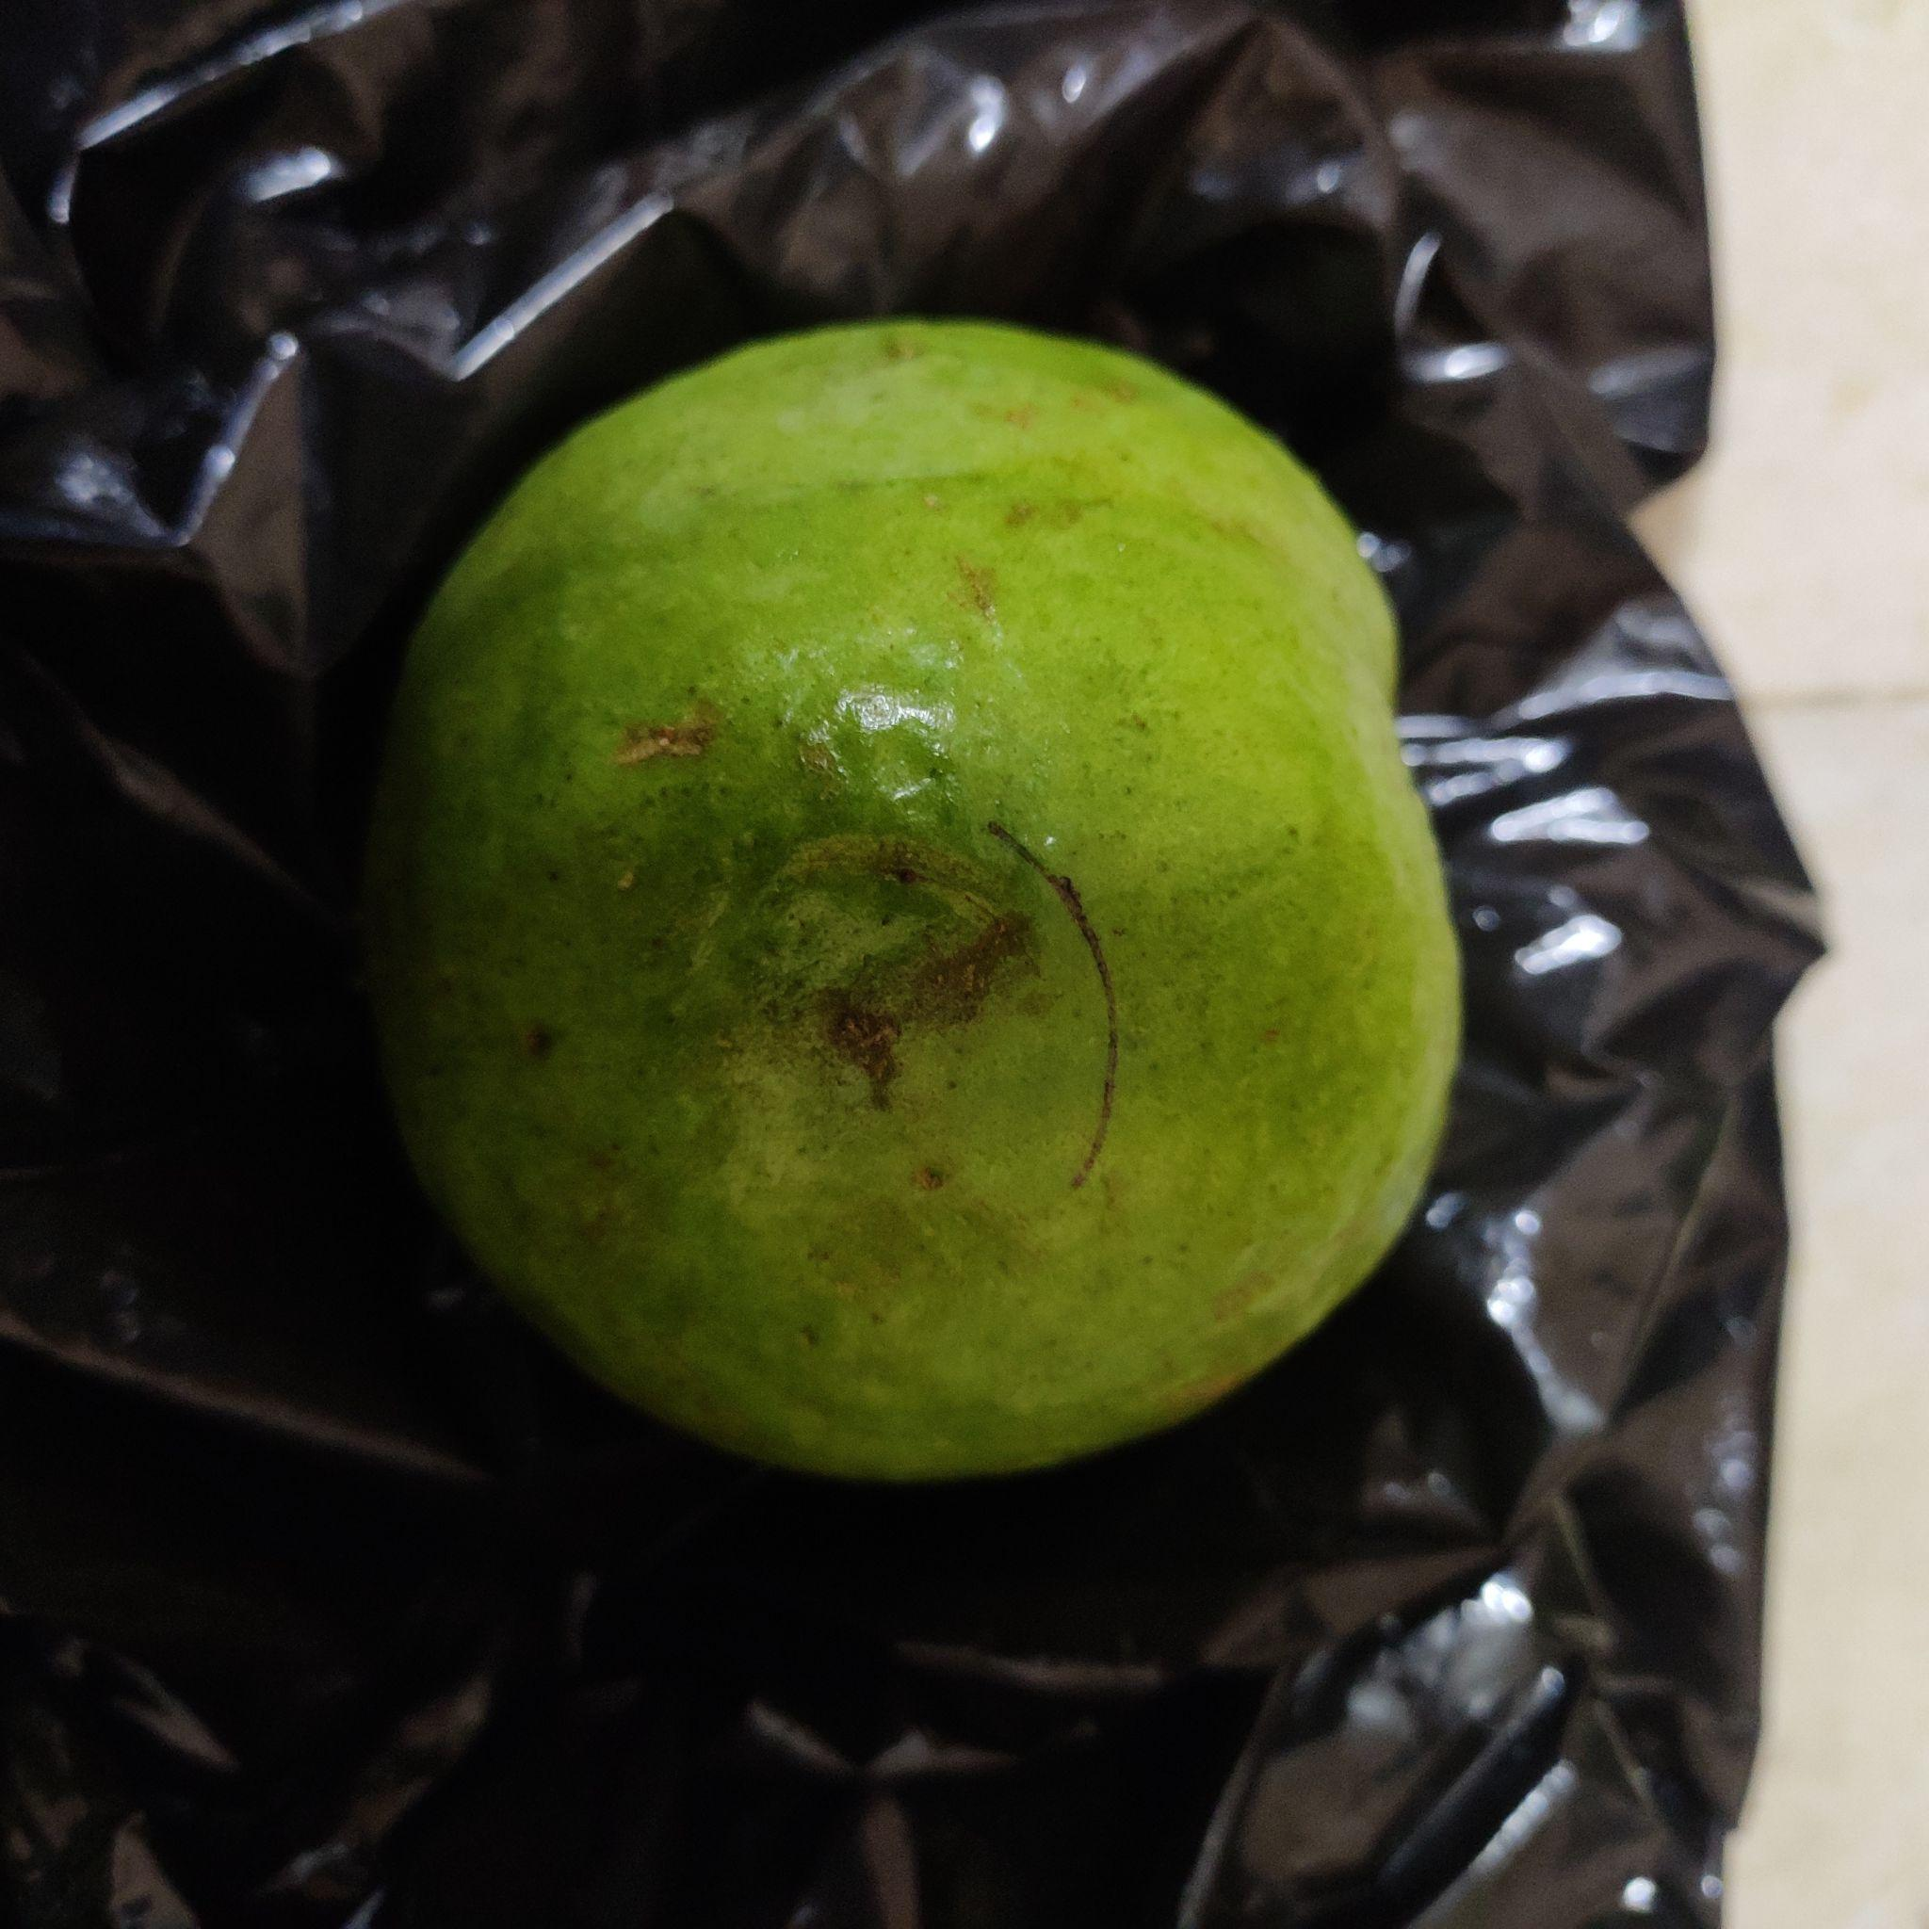
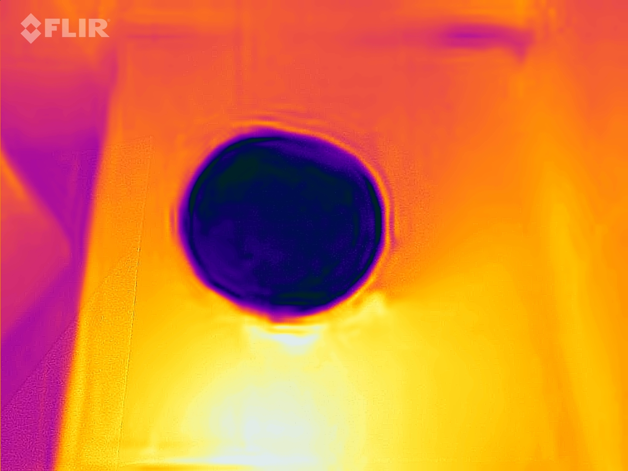
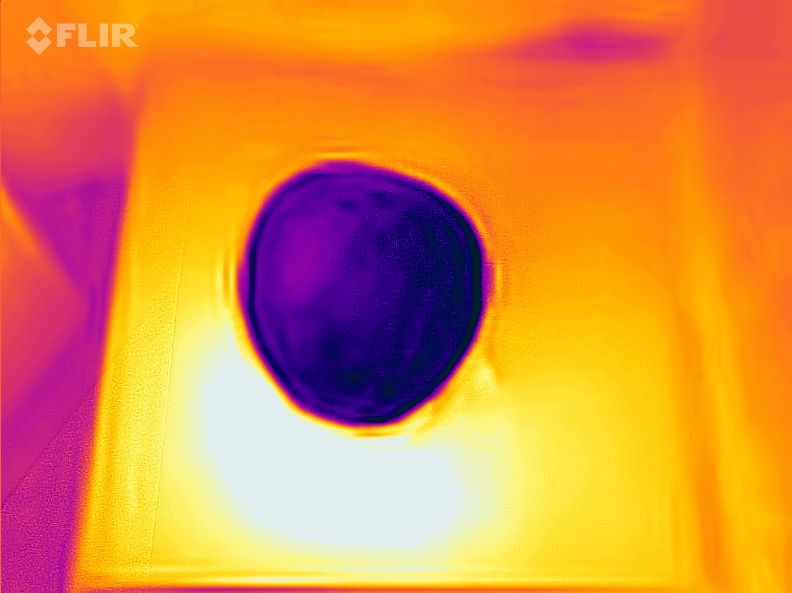
Motivation
Thermal images capture the temperature of the objects in the scene, which is not possible with RGB images.
Thermal images can be used to detect objects that are difficult to see in RGB images, such as animals in a forest or people in the dark
Dataset :https://data.mendeley.com/datasets/5kptnn7ycr/1

Slide 3
YOLO v8
YOU ONLY LOOK ONCE

Slide 4
Introduction to YOLO
YOLO (You Only Look Once) is an object detection algorithm that uses deep neural networks to detect and classify objects in images or videos.
The YOLO algorithm works by dividing an image into a grid of cells and predicting the objects contained in each cell.
It then predicts the probability of each object belonging to a predefined set of classes and generates a bounding box around the object to indicate its location in the image.

Slide 5
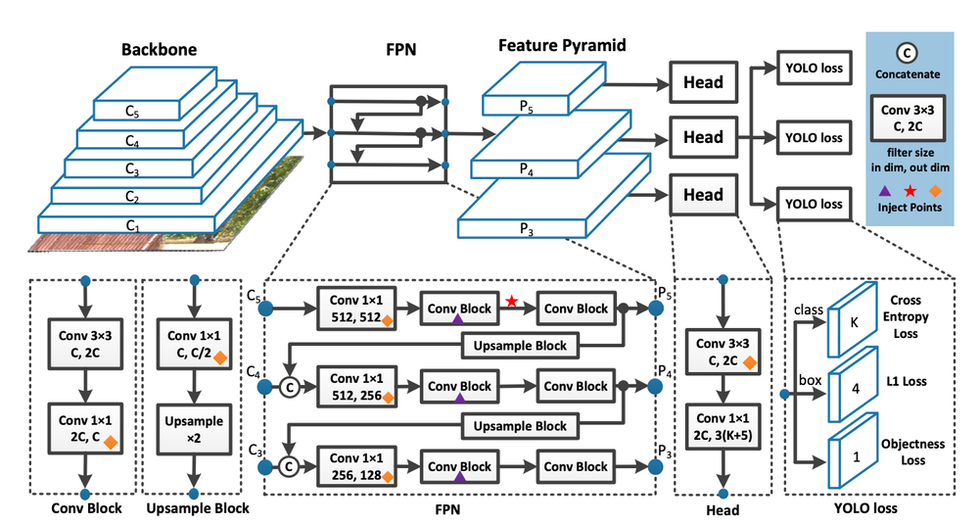
YOLO Architecture
https://blog.roboflow.com/yolov7-breakdown/

Slide 6
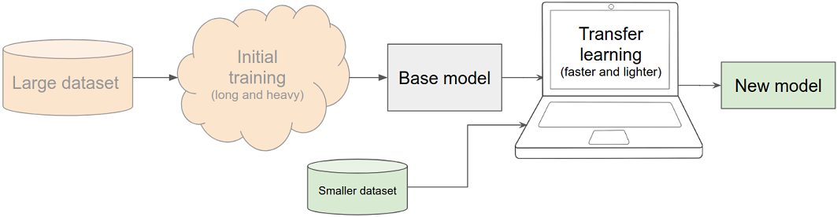
Transfer Learning
Transfer learning is a machine learning technique that involves using a pre-trained model as a starting point for solving a new task.
The process typically involves fine-tuning the pre-trained model on a smaller dataset for the new task, while retaining the weights of the earlier layers of the model.
Source link:https://livebook.manning.com/book/deep-learning-with-javascript/chapter-5/v-4/

Slide 7
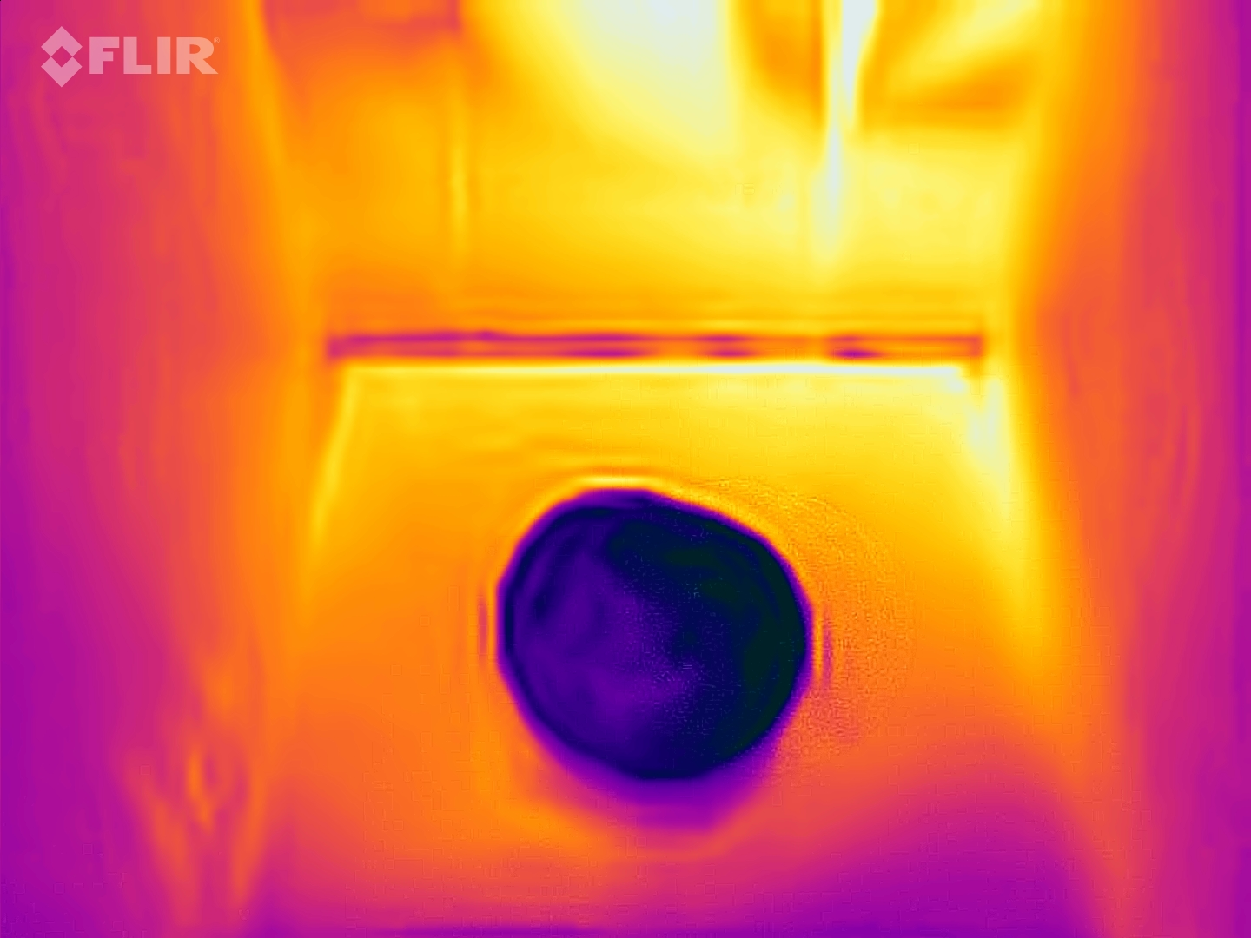
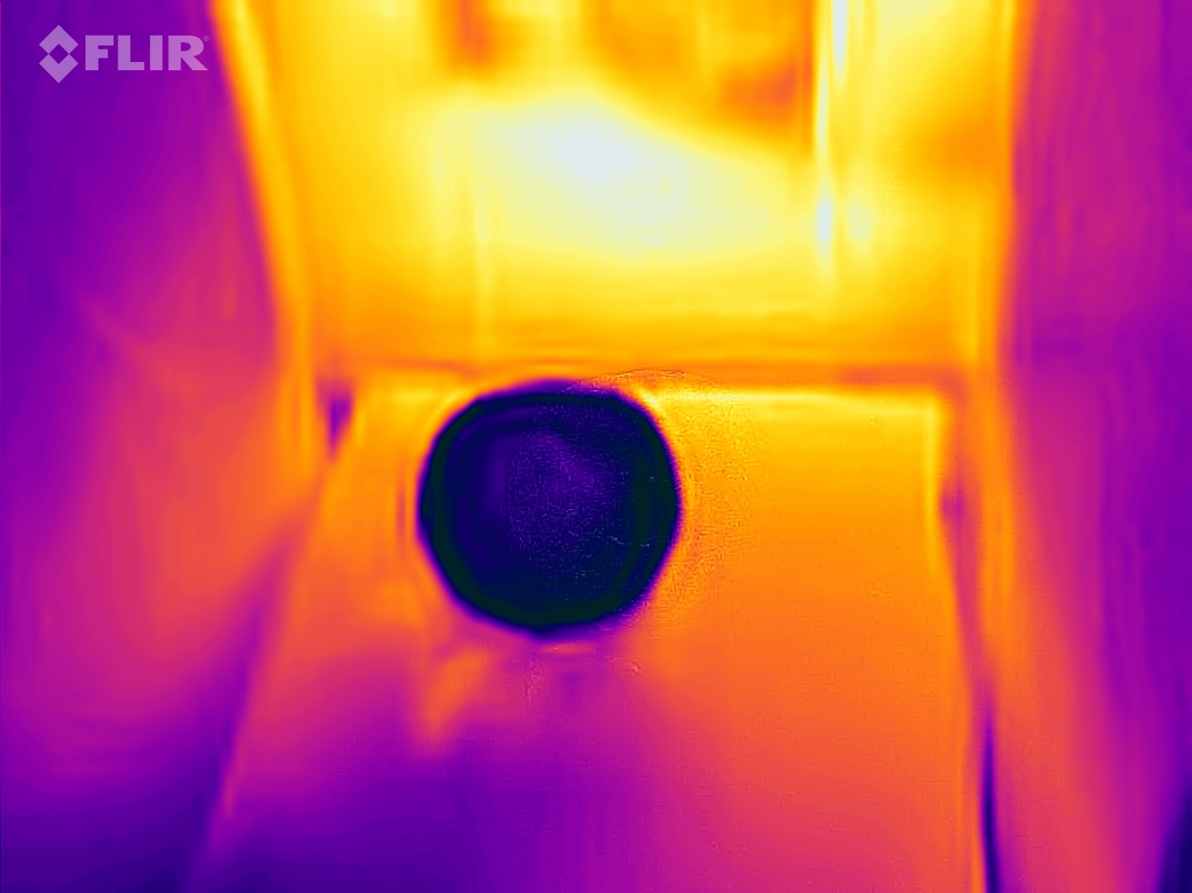
Guava Thermal dataset
Dataset | Images | Percentage
Test | 430 | 87%
Validation | 41 | 8%
Test | 26 | 5%
Ripen Guava
Data Augmentation :
Resize: Stretch to 640x640
Flip: Horizontal, Vertical
90° Rotate: Clockwise, Counter-Clockwise, Upside Down
Unripe Guava
Dataset :https://data.mendeley.com/datasets/5kptnn7ycr/1

Slide 8
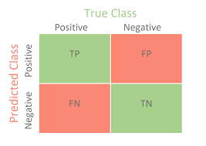
Performance Matrix
F1 SCORE= 2 * (precision * recall) / (precision + recall)
PRECISION= true positives /(true positives + false positives)
RECALL = true positives / (true positives + false negatives)
Confusion Matrix

Slide 9
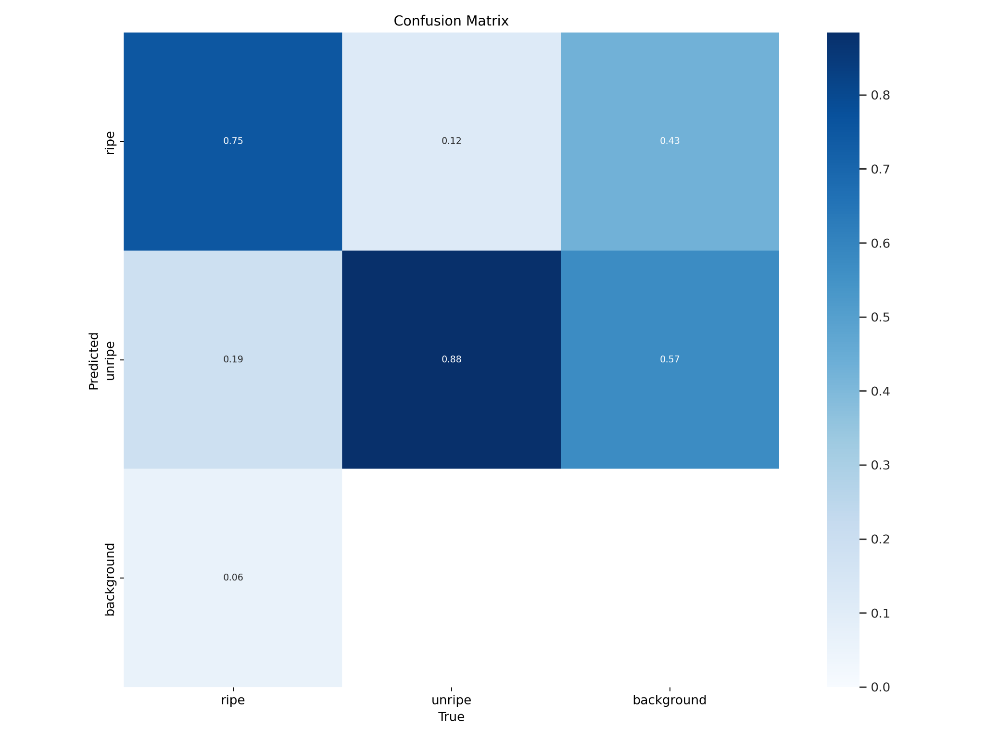
CONFUSION MATRIX

Slide 10
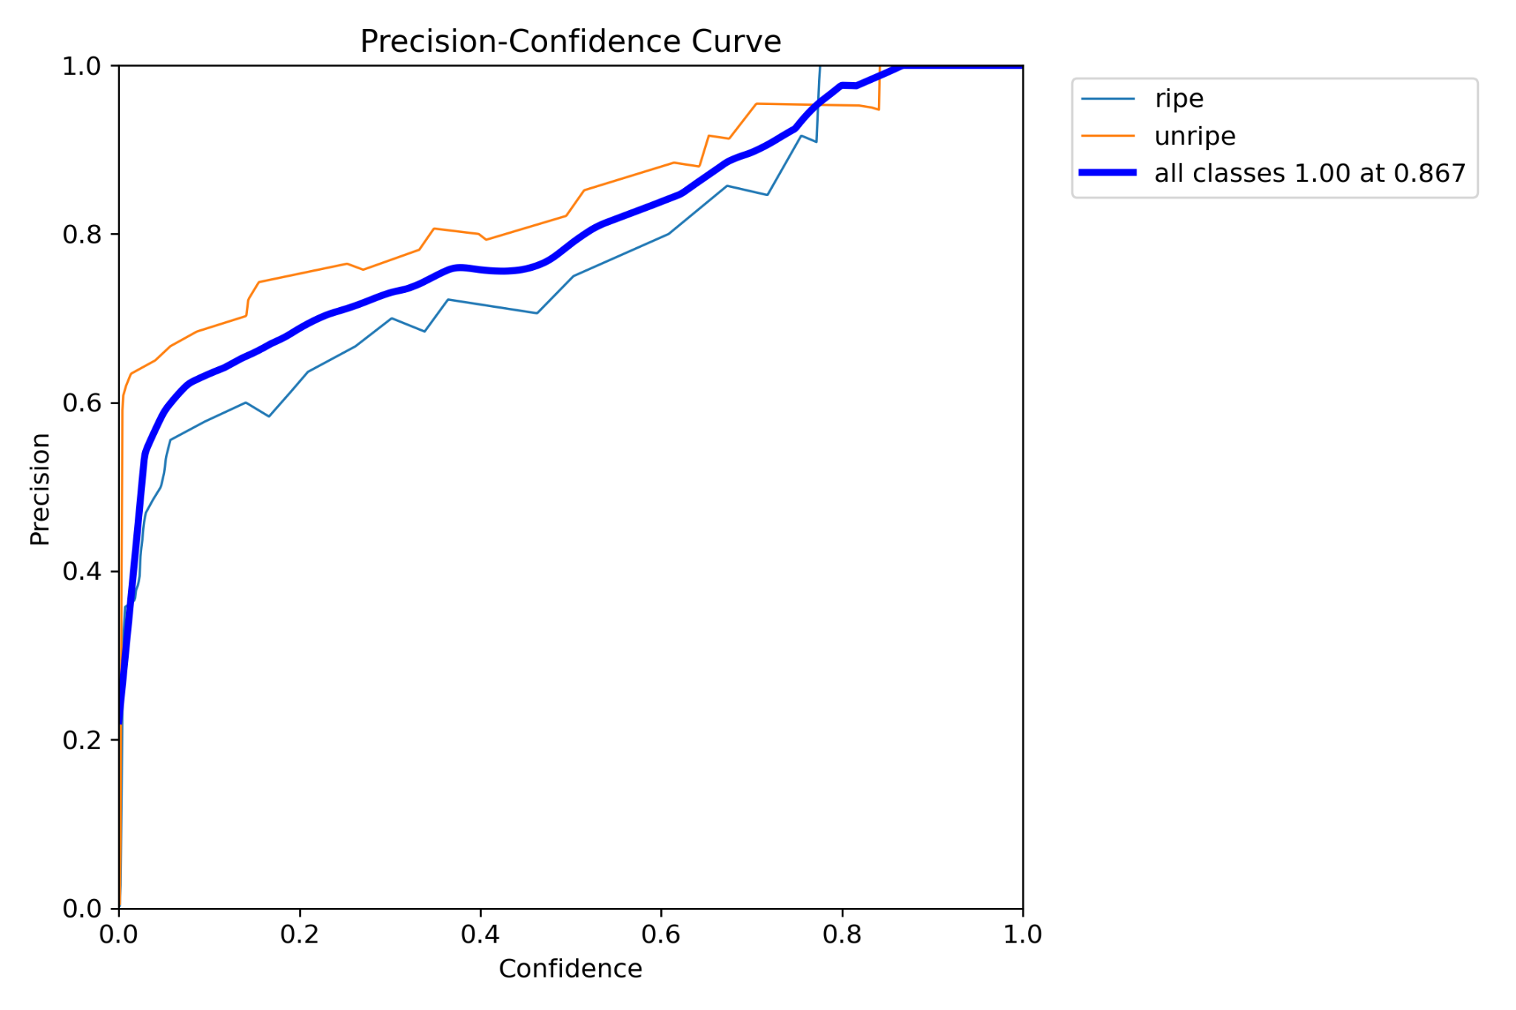
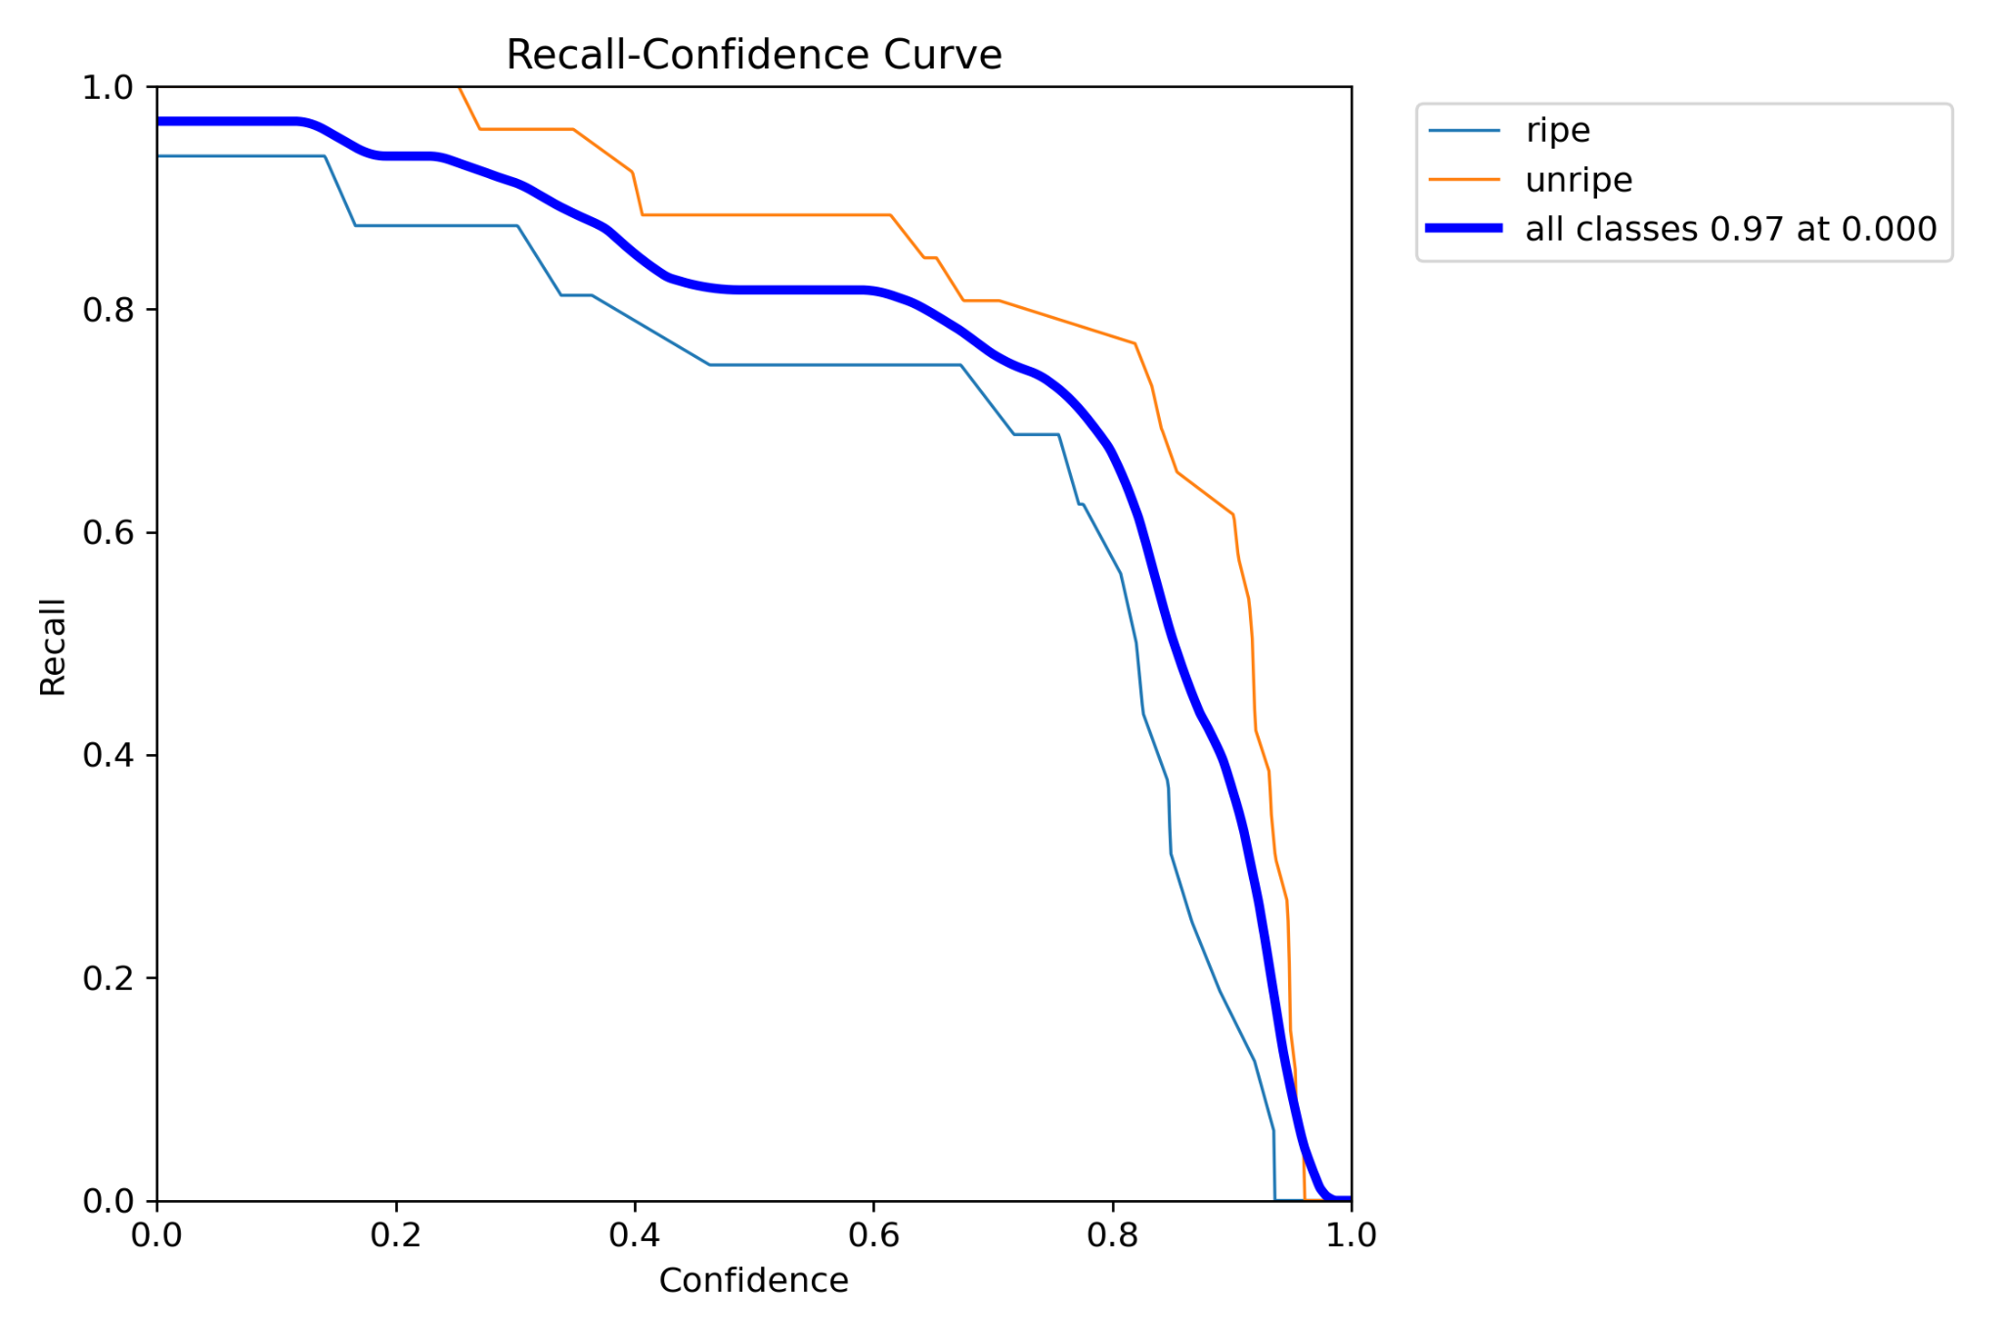
Precision and Recall Graphs
Precision Curve
Recall Curve

Slide 11
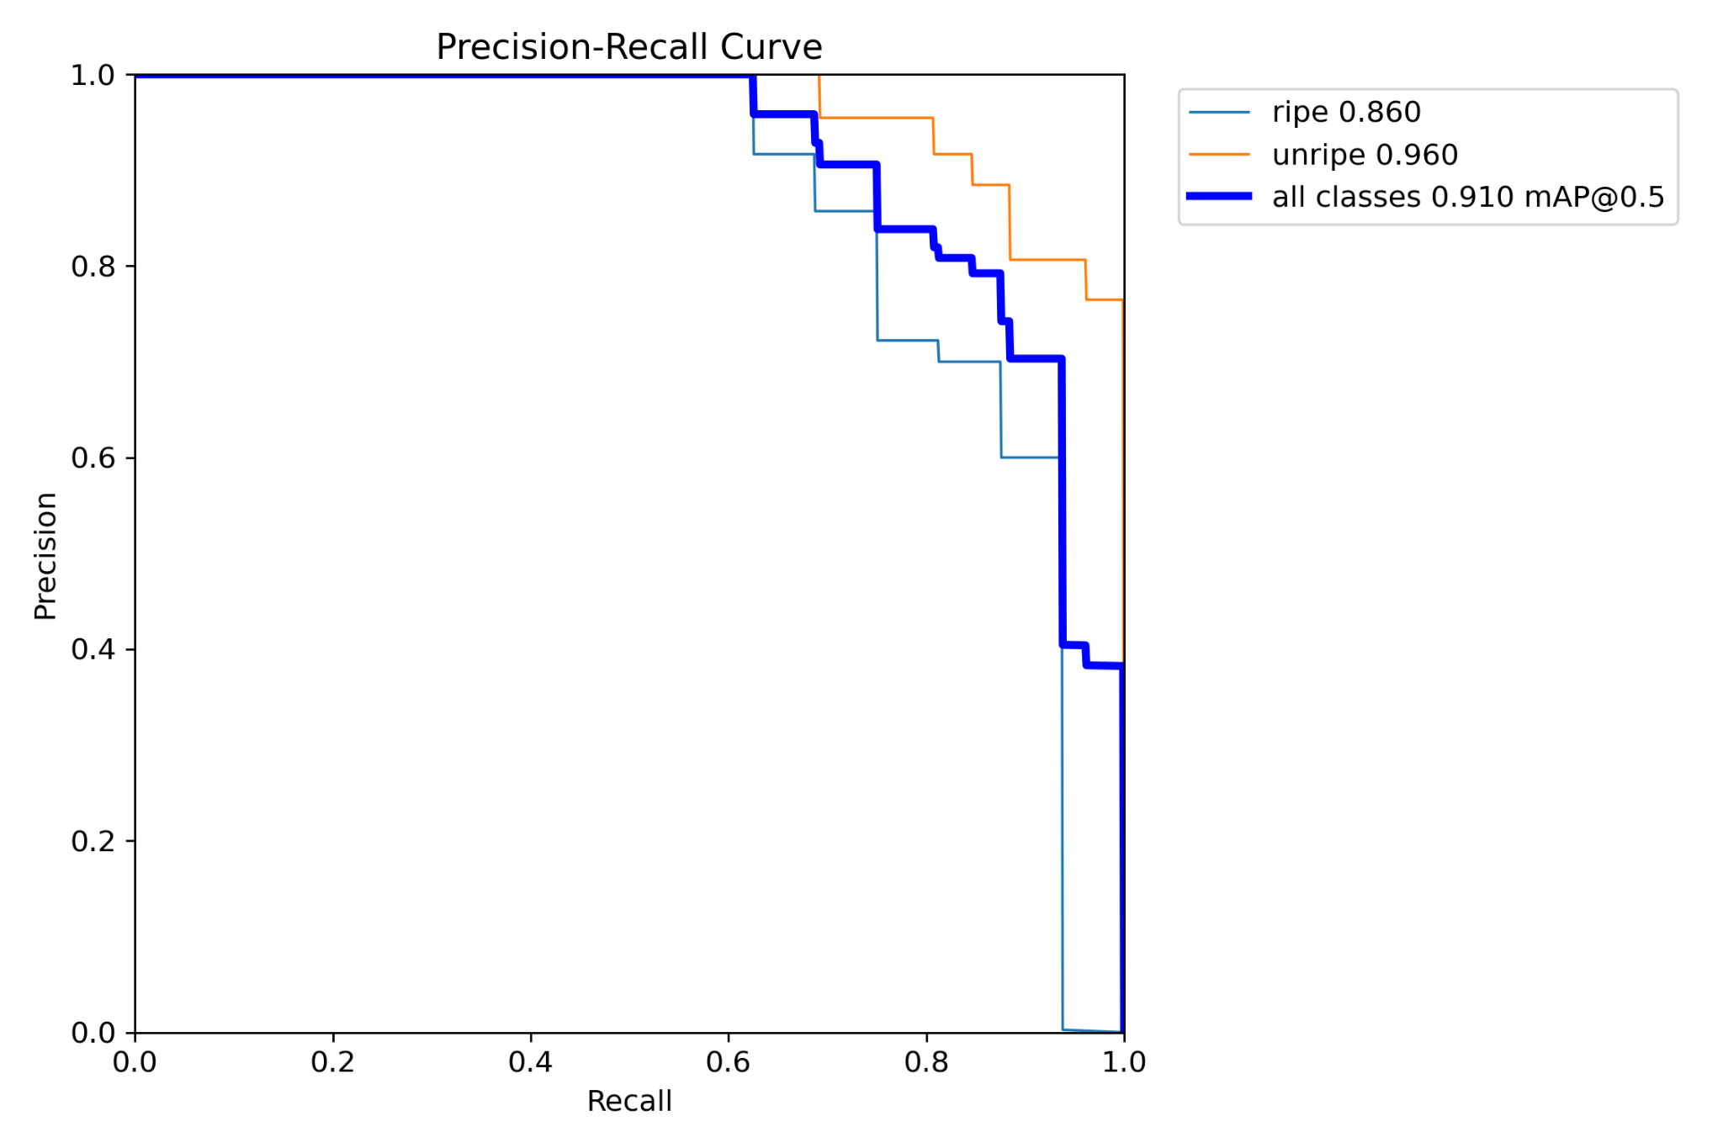
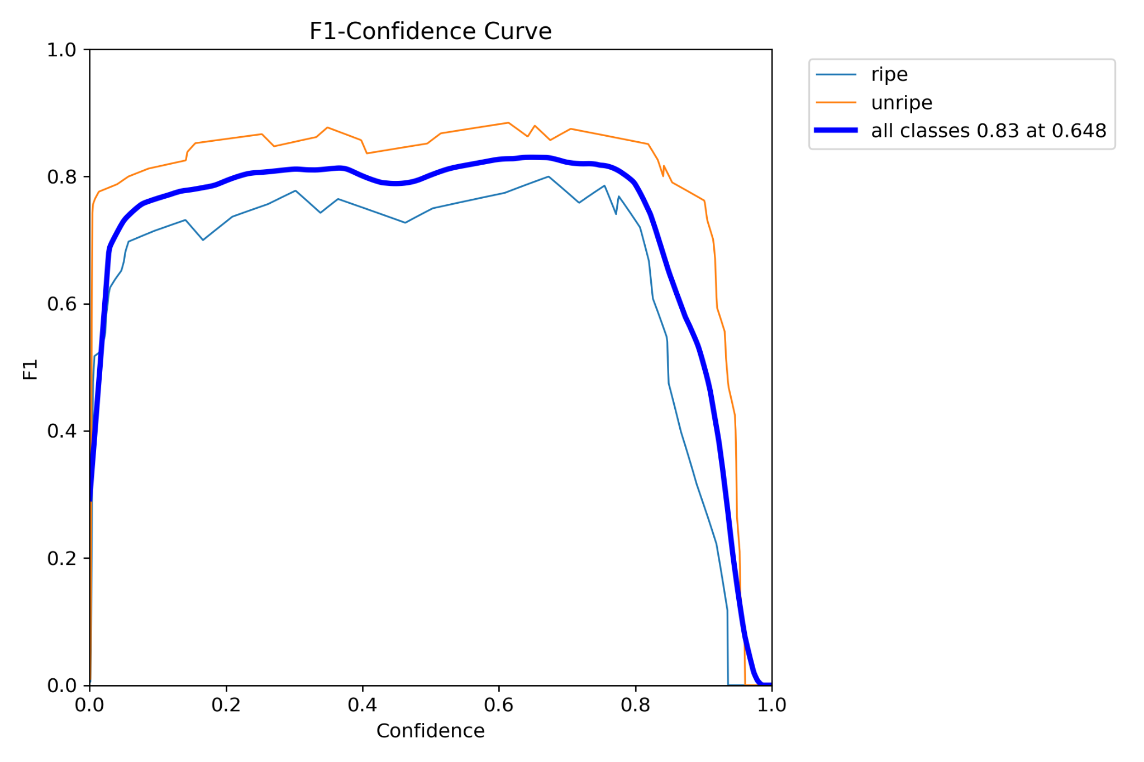
Precision vs Recall Curve, F1 score curve
Precision vs Recall Curve
F1 Score Curve

Slide 12
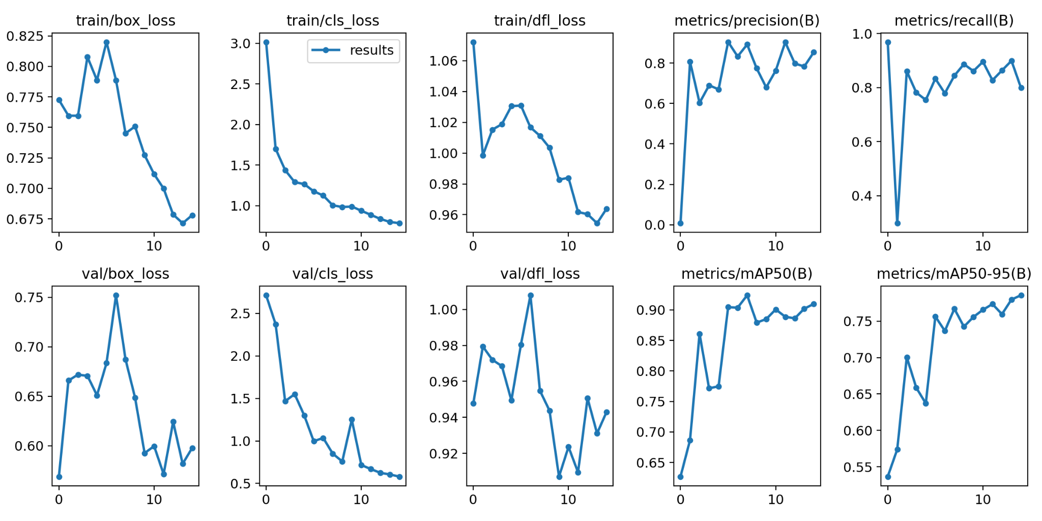
Results

Slide 13
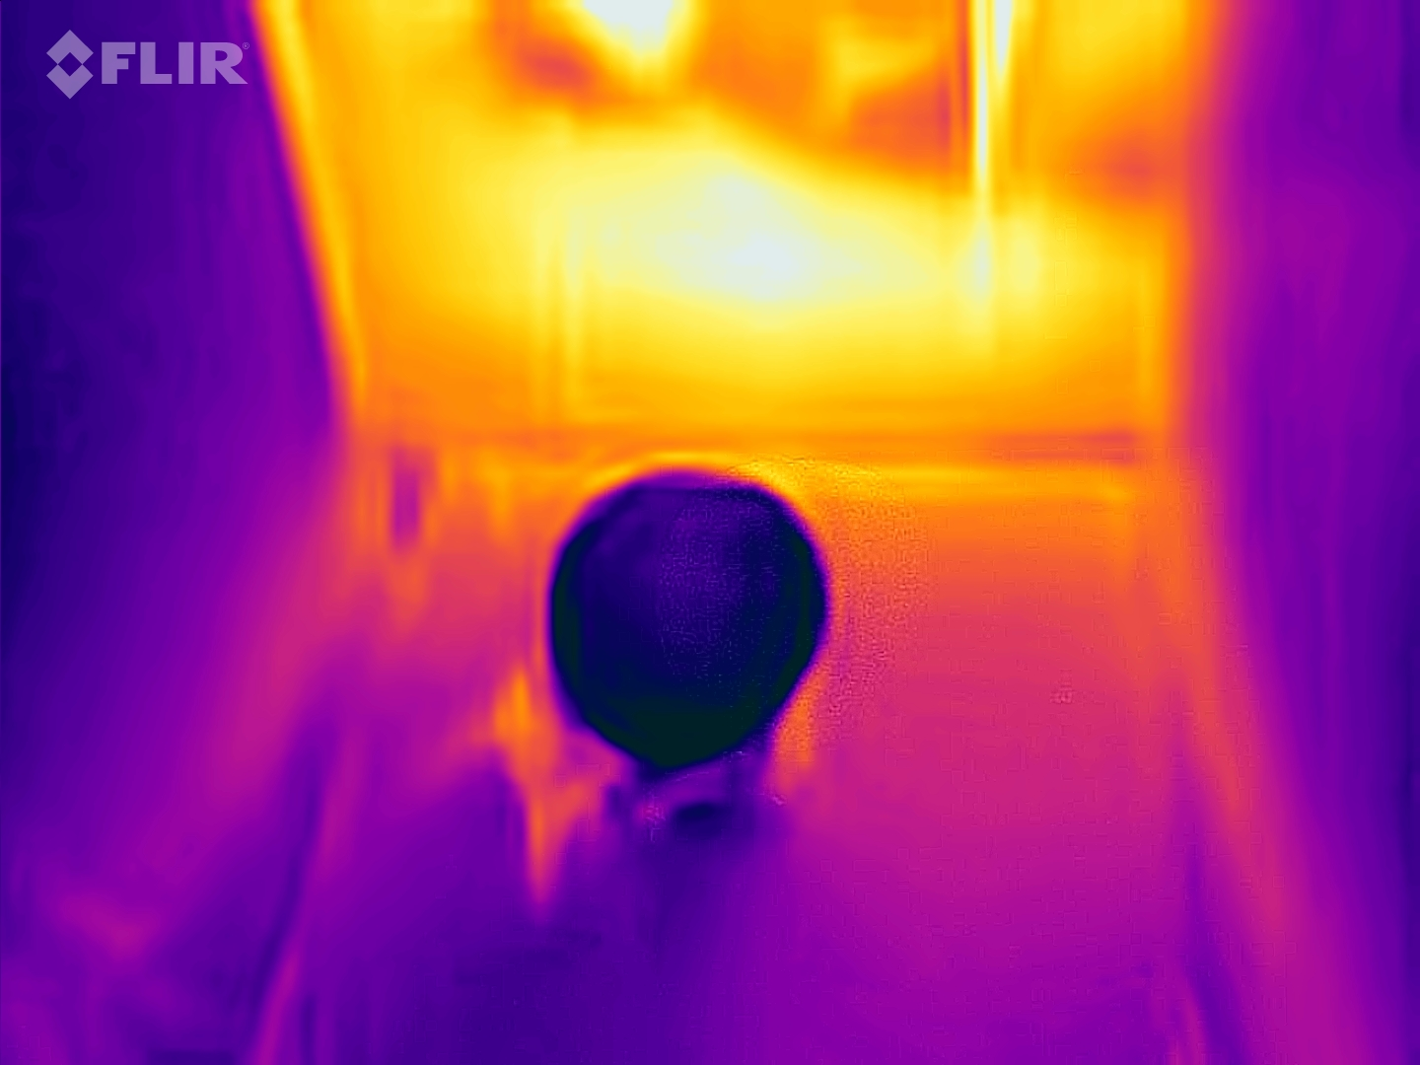
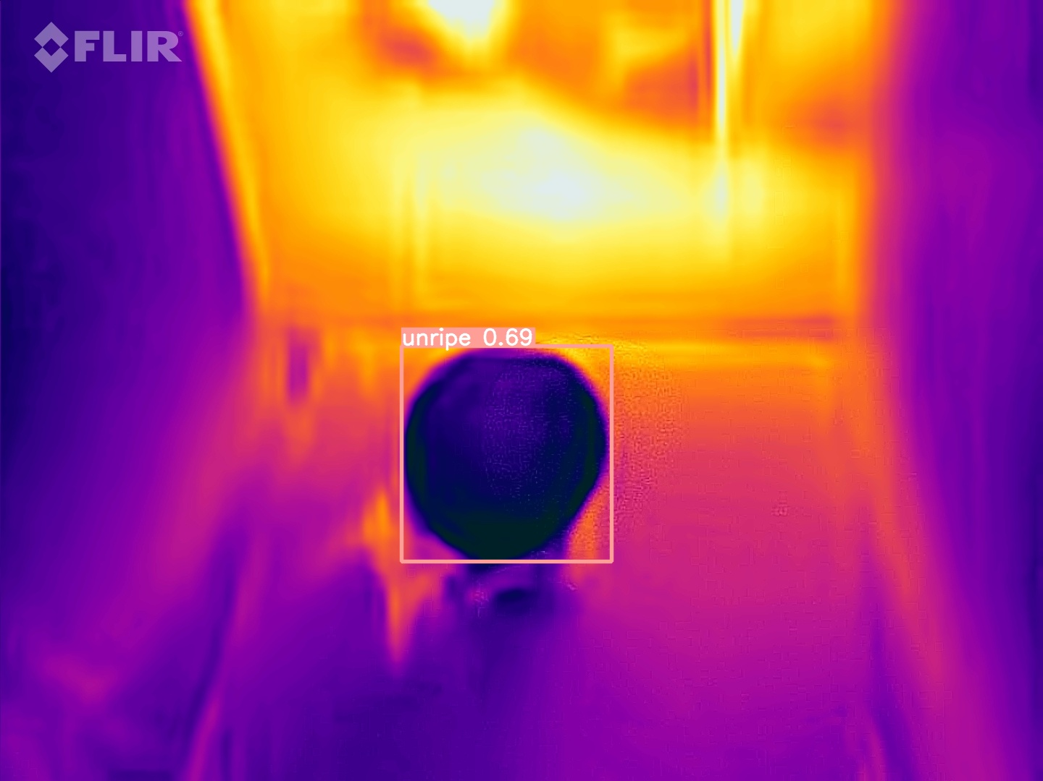
Detection of unripe Guava(15 CM)

Slide 14
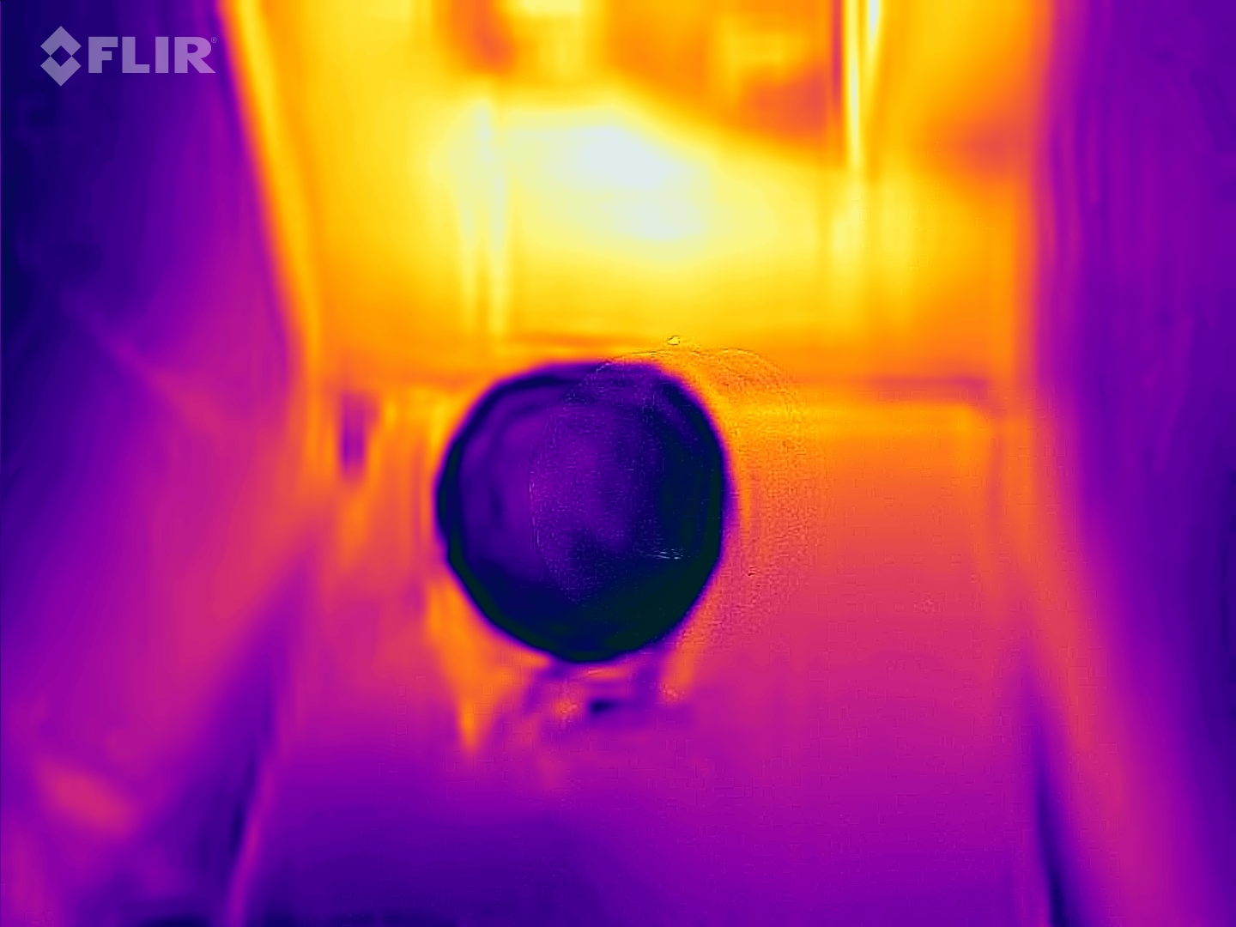

Detection of Ripe Guava(15 CM)

Slide 15
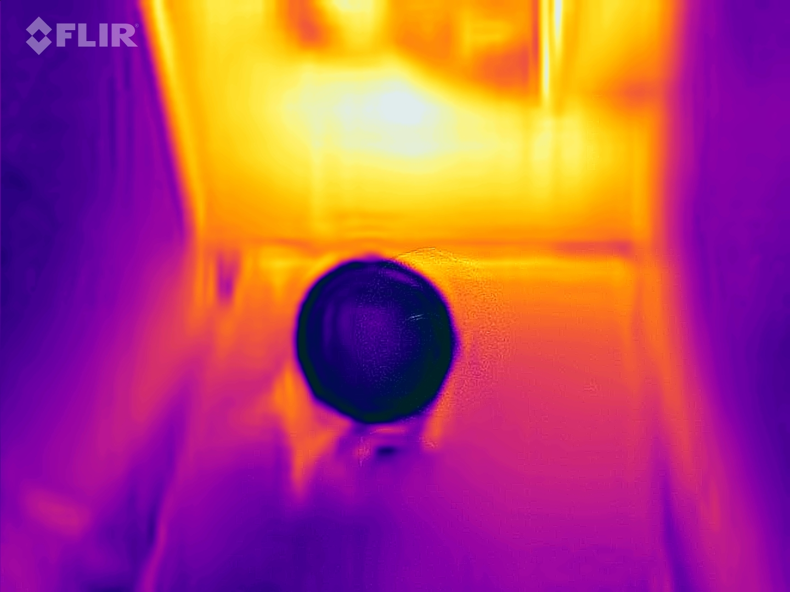
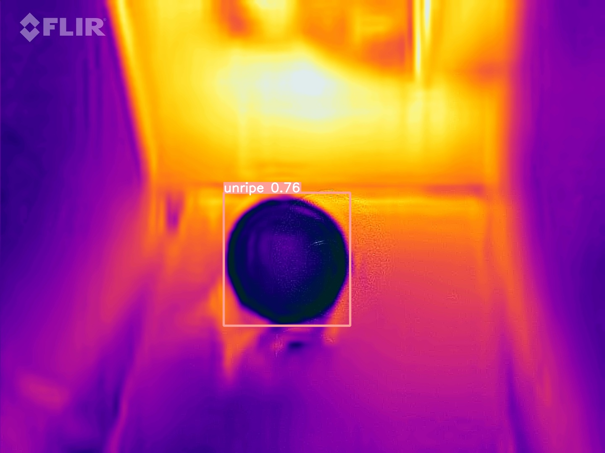
Detection of unripe Guava(30 CM)

Slide 16
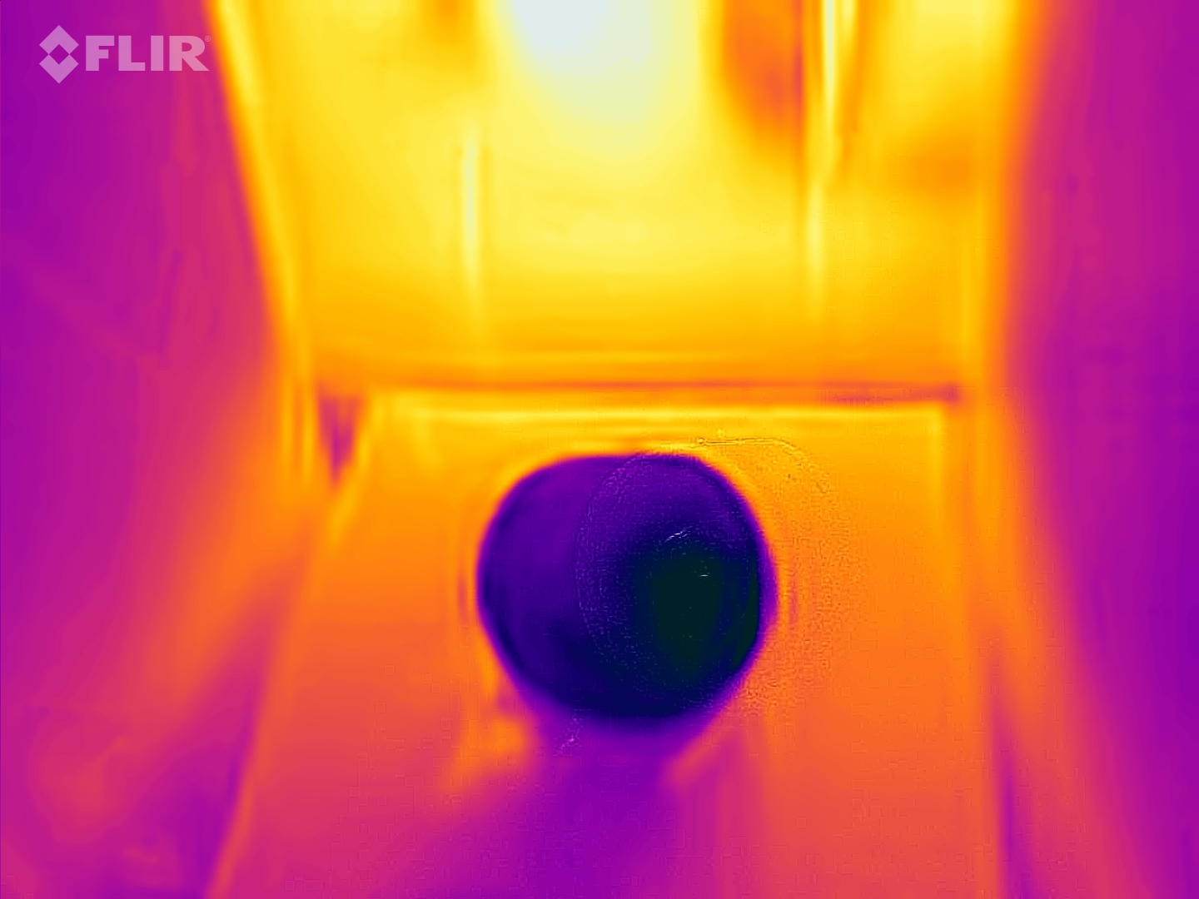
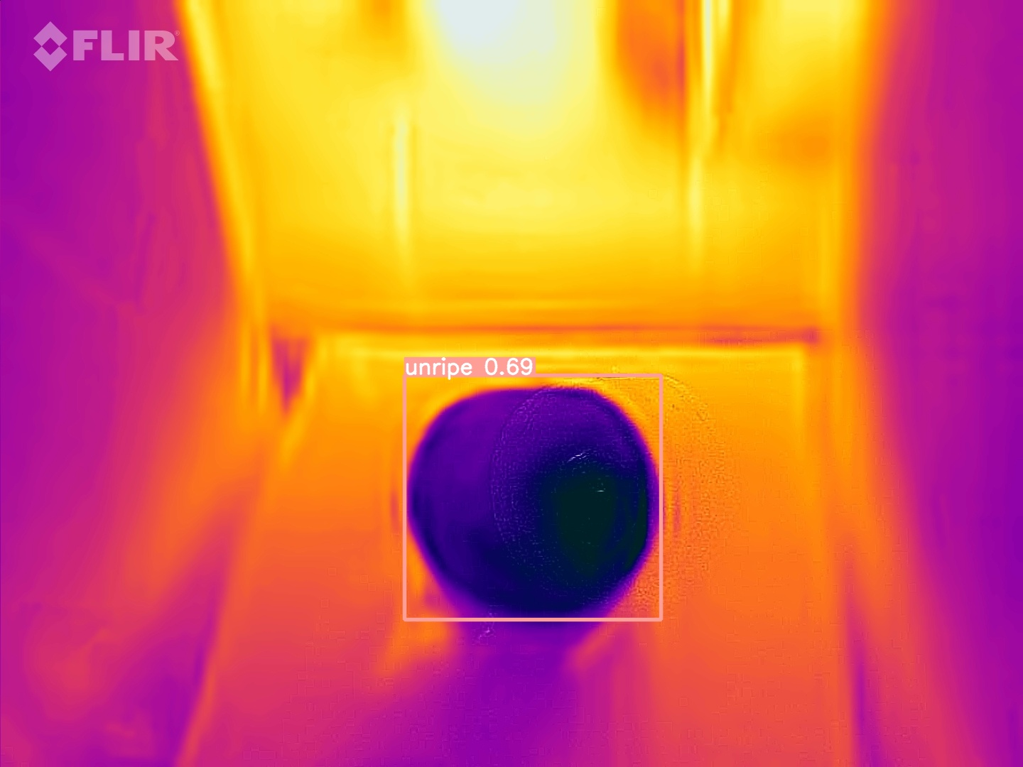
Detection of unripe Guava(45 CM)

Slide 17
Conclusion
We have annotated the data set by classifying the Guava into ripe , unripe using roboflow software.
We have built a model using YOLO v8 , which identifies the object (Guava) and classifies them as ripe , unripe.

Slide 18
Timeline of BTP
Stage 4
Proposing a CNN model for Object detection and classification on Thermal Dataset
4
Stage 3
Thermal Dataset Collection
Customization of YOLO v8 model using Transfer learning
3
Stage 2
Online Dataset(GUAVA)
Object detection using YOLO v8 by Transfer Learning.
2
Stage 1
Literature
Data Collection
1

Slide 19
Future Scope of Evaluation
Thermal dataset collection
Object(Mango) detection
Customisation of Yolo model using Transfer learning for object detection and classify into ripe or unripe.

Slide 20
Reference Papers
Mohd Ali M, Hashim N, Abd Aziz S, Lasekan O. Characterisation of Pineapple Cultivars under Different Storage Conditions Using Infrared Thermal Imaging Coupled with Machine Learning Algorithms. Agriculture. 2022 Jul 13;12(7):1013.
Naik S, Patel B. Thermal imaging with fuzzy classifier for maturity and size based non-destructive mango (Mangifera Indica L.) grading. In2017 International Conference on Emerging Trends & Innovation in ICT (ICEI) 2017 Feb 3 (pp. 15-20). IEEE.
Bhole V, Kumar A. Mango quality grading using deep learning technique: Perspectives from agriculture and food industry. InProceedings of the 21st annual conference on information technology education 2020 Oct 7 (pp. 180-186).

Slide 21
THANK YOU

